Slide 1





PS-1 ENDSEM Project Presentation

Slide 2

Project Title
Rate Reasonability for Scrap Disposal and Price Prediction of lot
Submitted By:
Name: Arush Shetty
BITS ID: 2021A3PS2661P
Faculty in charge: Ashish Narang
Name of Organization: Centre For Railway Information Systems
Birla Institute of Technology and Science, Pilani

Slide 3
In this comparative study, we will explore three key aspects of a commodity: analyzing auction prices, predicting future prices, and assessing the reasonability of scrap disposal.

Slide 4


About the Center for Railway Information Systems (CRIS)
The Indian Ministry of Railways manages the Centre for Railway Information Systems (CRIS), which is owned by the Indian government. It opened in 1986 and has been going strong ever since at its original location in Chanakyapuri, New Delhi.
The Central Railway Information System (CRIS) aims to improve the efficiency, safety, and quality of the services offered by the Indian Railways to their customers.

Slide 5

About Scrap
The term "scrap" encompasses a variety of products, including motor generators, batteries, motors, and iron locomotives. For the purchase of recycled metal, there is a vast selection of online auction websites.
First, lots are constructed from previously discarded refuse material.
"Lot formation" refers to the process of amassing a significant quantity of a specific type of commercially viable scrap material to pique the interest of prospective bidders at an auction.

Slide 6

3500-4000 cr
During the 2011–2012 fiscal year, the Indian Railways sold scrap with a value between

Slide 7
The 3 step process used:
PRICE PREDICTION USING ML MODELS
3
3
DATA CLEANING
2
SELECTING A COMMODITY WHICH HAS GOT MANY FEATURES COMMON
1

Slide 8
1.Commodity selected :rails
Rails are of different types
52kg
60kg
50r
60r
75r
90r
50bh
Features selected were length and the quantity of the rails

Slide 9
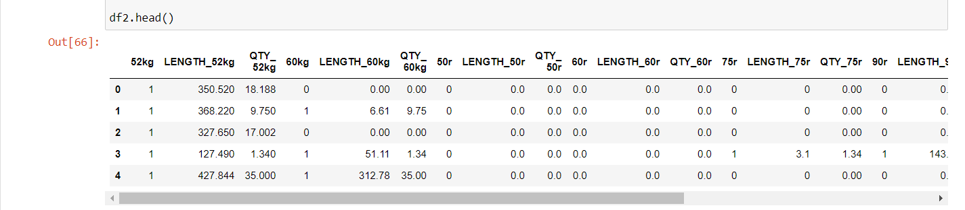
2.Data Preprocessing
The data provided contained a lot of data entries and needed a lot of manual preprocessing
Since there were many data entries which had more than one elements like 52kg + 60kg , so decided to proceed using categorical analysis . for eg is 52kg is present it would be marked as 1 else 0

Slide 10
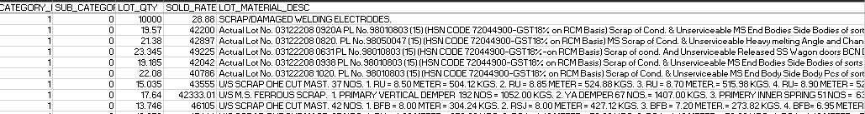
Converted the raw data into categorical data in which every variety,length and sold price was mentioned
Required sorting and filtering the data multiple times in excel
Basically the input features were given in the LOT_MATERIAL_DESC column so i had to separate out the categories from this one column and create different columns

Slide 11
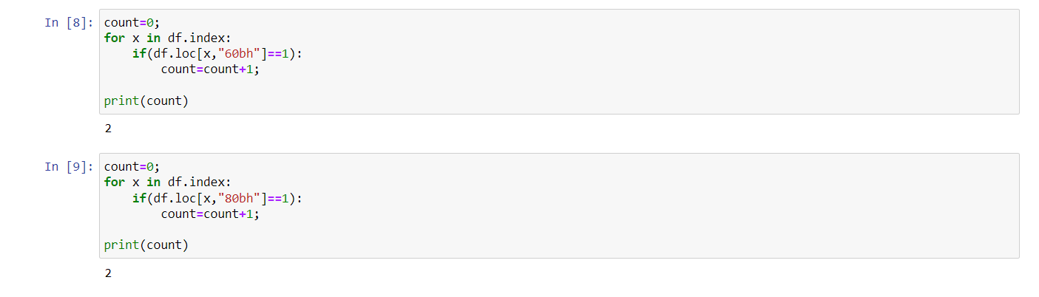
Data Cleaning
Removed columns who had very less entries (variety 60bh and 80bh rails)
Removed ambiguous data from the excel file
Removed outliers especially in 52 kg and 60 kg rails, as these have many entries in jupyter notebook
So 60bh and 80bh have only gotten 2 entries each !
Can remove them as they wont give accurate predictions

Slide 12
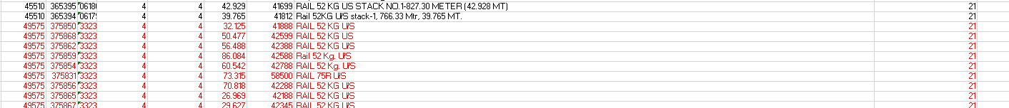
Removing inconsistencies in data
Here 52kg rails are being used but the length and the weight are not mentioned and hence cannot be used for data analysis
Similarly there were many rails whose variety was given but their length and the weight were completely missing without which the data analysis would become an impossible task

Slide 13
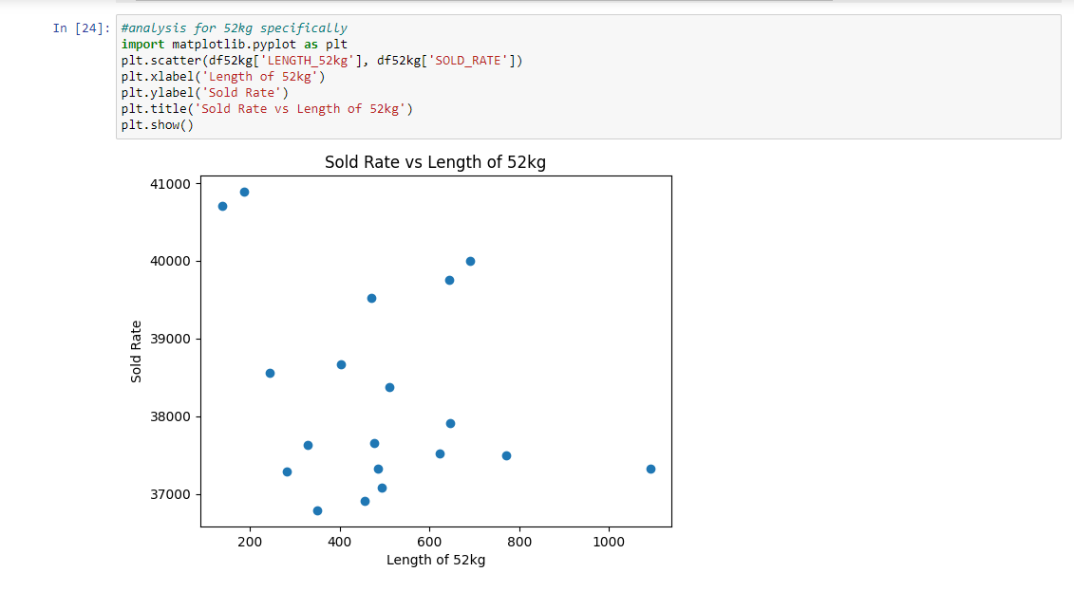
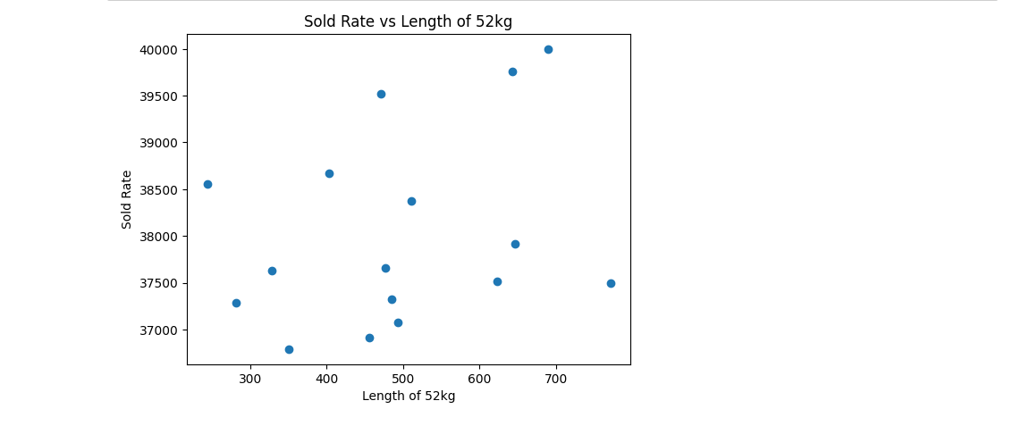
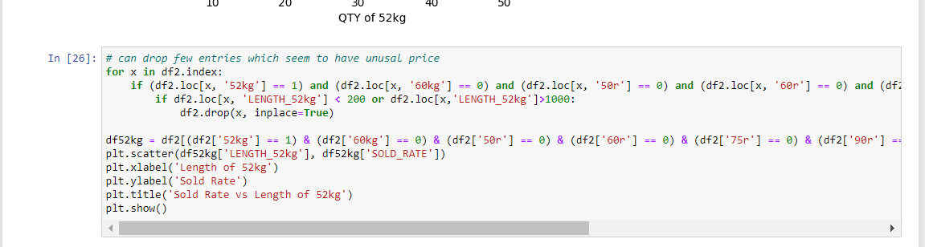
II. Removing the outliers. For eg here even when the length is so less the price is extremely high

Slide 14
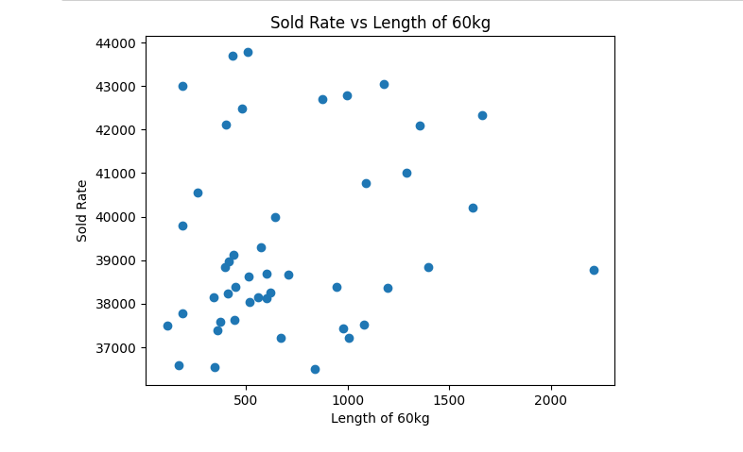
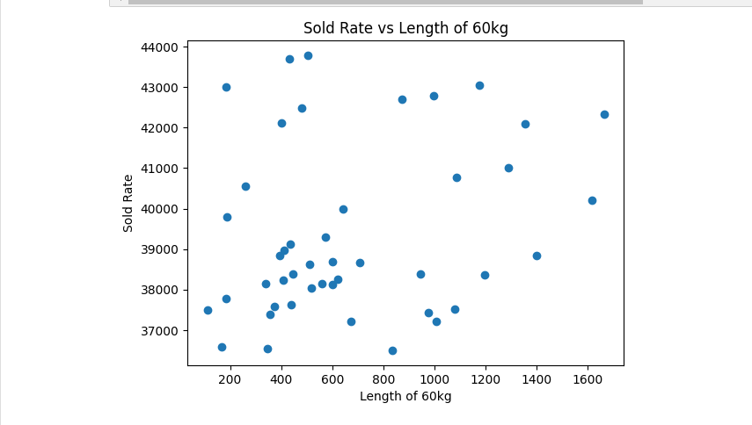
Same process done for 60kg variety rails also
Length is very high but still the price is very low

Slide 15
Statistical analysis and modeling:
In my project, I aimed to minimize error by exploring different models and selecting the best one for my analysis. I initially tried using the K-Nearest Neighbors (KNN) regression and Linear Regression, and found that Linear Regression yielded a lower error rate.

Slide 16
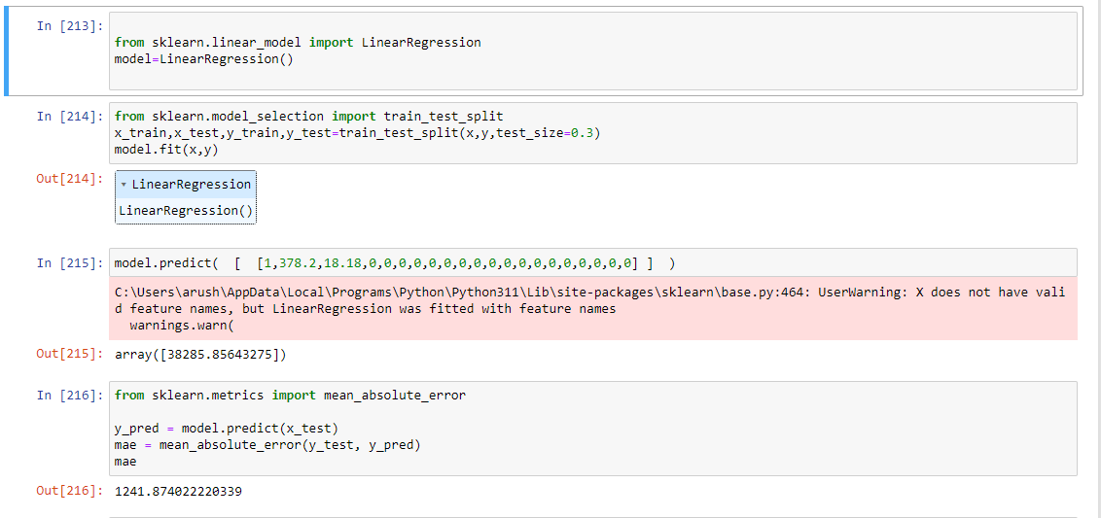
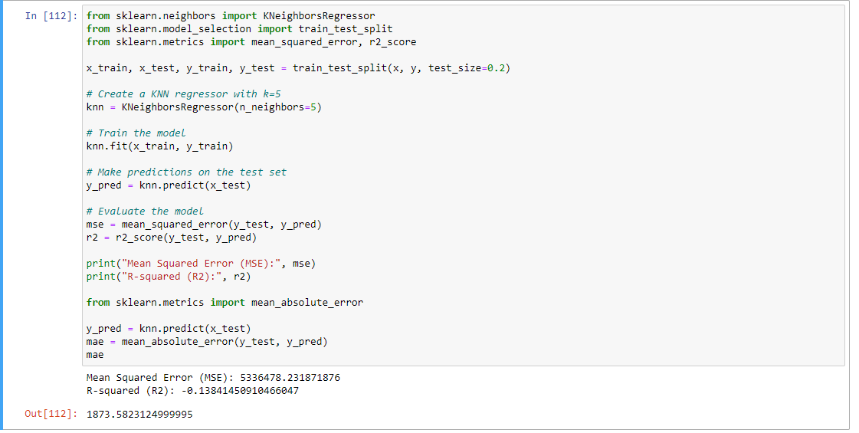
Linear Regression
KNN Regression
Much higher error

Slide 17
Working of the Model
Lets take up an example of a lot which only contains the 52kg variety rails
Let its length be 378.2mtr and qty be 18.18MT
So we need to follow this particular way of writing the inputs
[ 52kg, Length_52kg, QTY_52kg, 60kg, Length_60kg, QTY_60kg, 50r, Length_50r, QTY_50r, 60r, Length_60r, QTY_60r, 75r, Length_75r, QTY_75r ,90r, Length_90r, QTY_90r , 50bh, Length_50bh, QTY_50bh ]
According to this our data the input must be in the format of
[1,378.2,18.18,0,0,0,0,0,0,0,0,0,0,0,0,0,0,0,0,0,0]

Slide 18
Working of the Model
The output price for such a lot is predicted out by the linear regression model which is used
1 represents that 52kg rail is present
378.2 is the length of the rail
18.18 is the weight of the rails in MT(Mega Tone)

Slide 19

Thanks!

